Slide 1
OPEN DATA & KNOWLEDGE GRAPHS
GROUP 20
Salvador Campillo Morales, Joao Diogo Martines Romao, Ricardo Carvalho, Adam Saleh Seffo, Mahmoud Almizel

Slide 2
Project selection and sources
Organizations legally registered in Madrid City Council records
Charities
Entrepreneurial lobbies
School boards
Sports clubs
Cultural associations
…
Different kinds of organizations
Associations
Federations
Foundations
Collectives
A .csv dataset per kind of organization (see datasources)

Slide 3
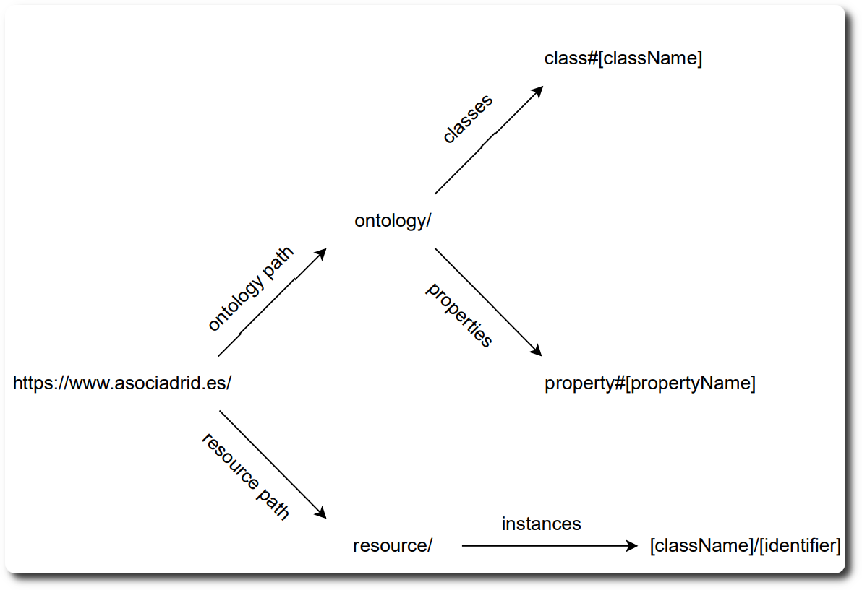
Project development - first stages
Requirements and license analysis
Dataset structure analysis
Resource naming strategy

Slide 4
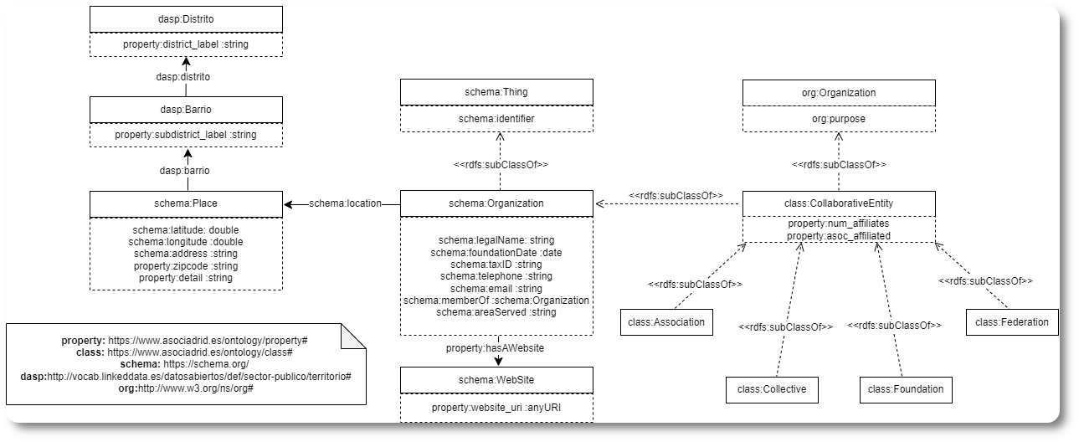
Project development - ontology

Slide 5
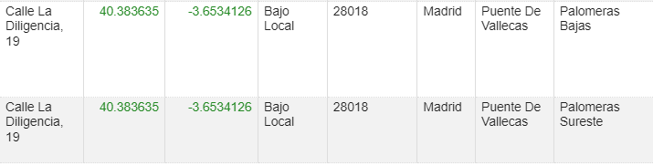
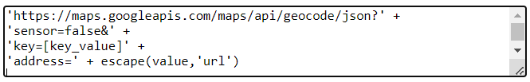
Project development - csv cleansing
Iterative process.
Some interesting transformations.
Homogenization
Data augmentation:
latitude
longitude
Inconsistency fixing
Data linking
Select variable >Edit column > Add column by fetching URLs

Slide 6




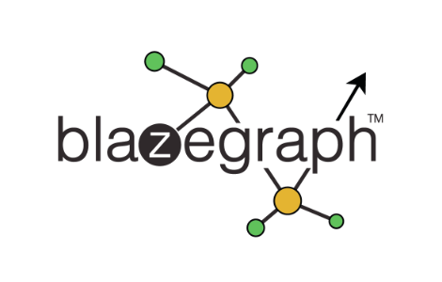



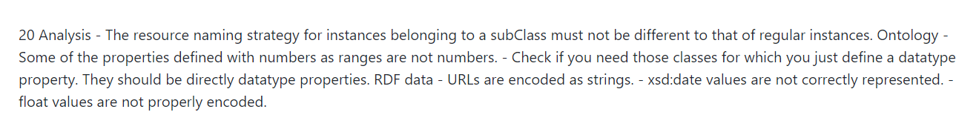
Project development - mappings/kg generation
SPARQL endpoint
8 triplemaps
58.988 triples (linked dataset)
1.344 links with wikidata entities
Also an iterative process. Error fixing given the feedback

Slide 7
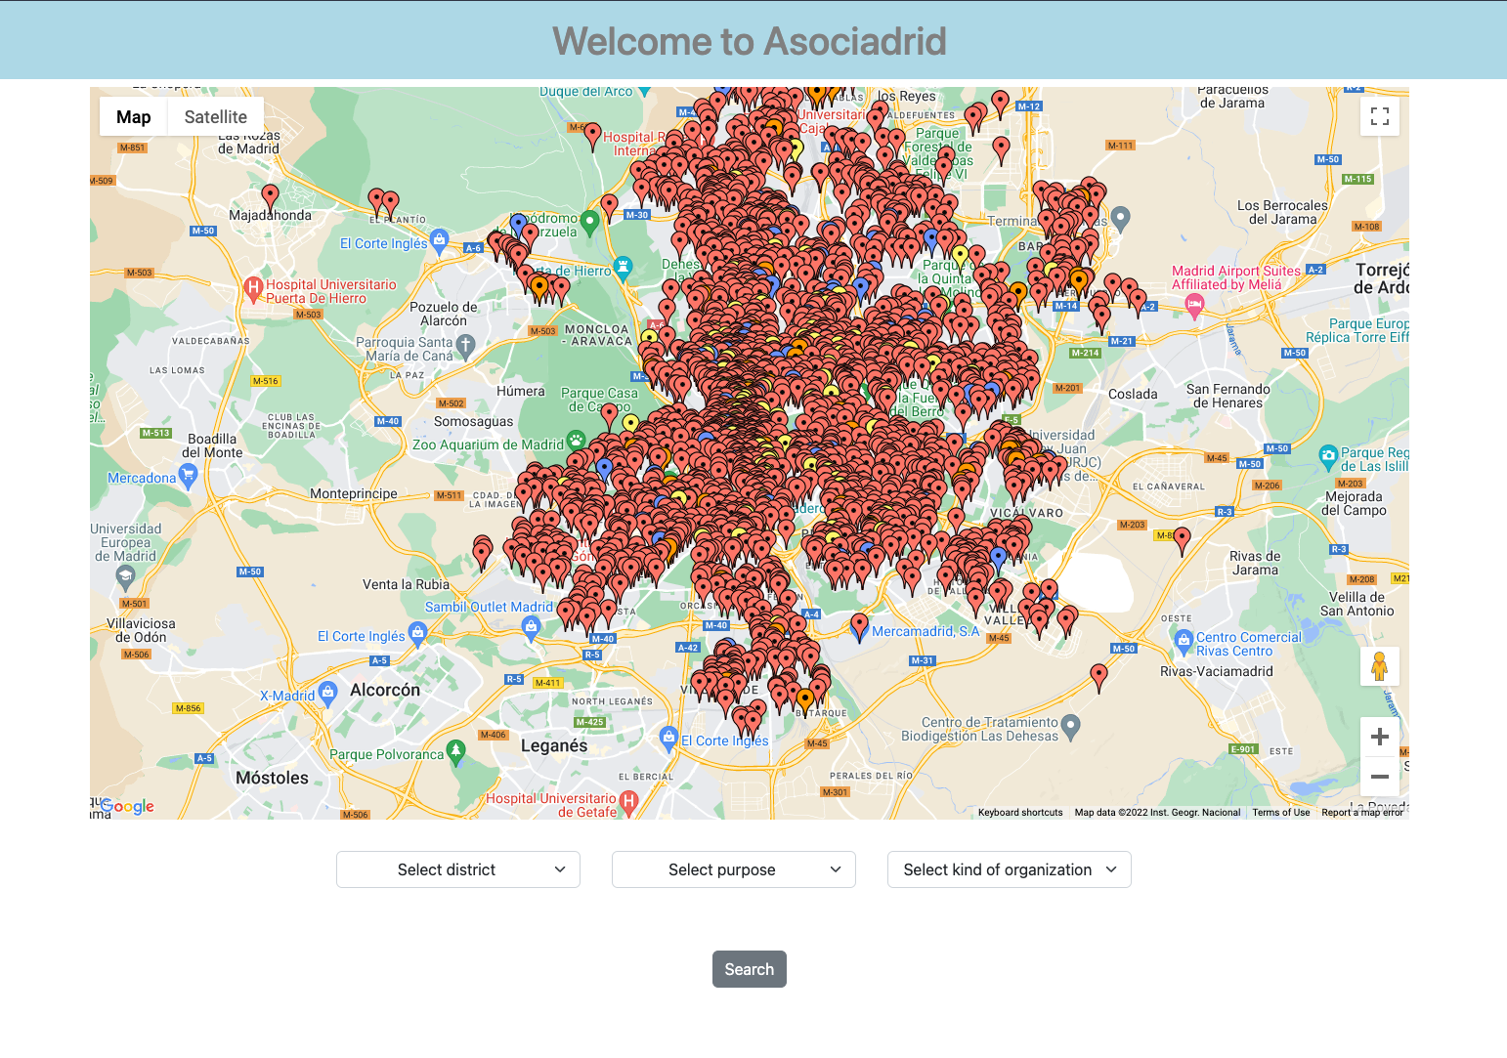
Our application
Simple web application using html, css and javascript + Flask.
Uses Python’s rdflib library to read the knowledge graph and execute GRAPHQL queries to retrieve data.
Communicates with Google Maps APIs.
Locates the organizations present on our knowledge graph.
Allows content filtering by:
district
subdistrict
organization purpose
organization type

Slide 8
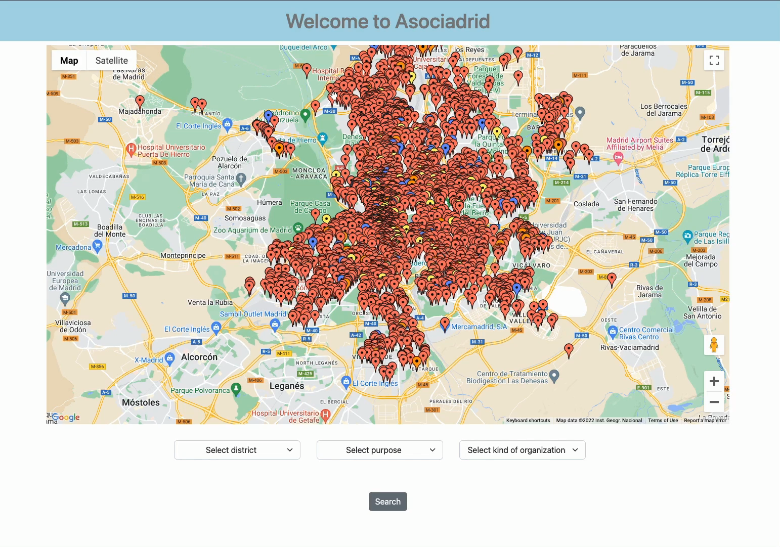

Slide 9

Thanks for your attention!

Slide 10
Datasources
Collectives datasource: https://datos.madrid.es/sites/v/index.jsp?vgnextoid=983de3811af52710VgnVCM1000001d4a900aRCRD&vgnextchannel=374512b9ace9f310VgnVCM100000171f5a0aRCRD
Foundations datasource:
https://datos.madrid.es/sites/v/index.jsp?vgnextoid=ef4bcfc2d84a5610VgnVCM1000001d4a900aRCRD&vgnextchannel=374512b9ace9f310VgnVCM100000171f5a0aRCRD
Federations datasource:
https://datos.madrid.es/sites/v/index.jsp?vgnextoid=b6f3532315dd3410VgnVCM1000000b205a0aRCRD&vgnextchannel=374512b9ace9f310VgnVCM100000171f5a0aRCRD
Associations datasource:
https://datos.madrid.es/sites/v/index.jsp?vgnextoid=5628ae43b6d85410VgnVCM100000333a5a0aRCRD&vgnextchannel=374512b9ace9f310VgnVCM100000171f5a0aRCRD

